Slide 1








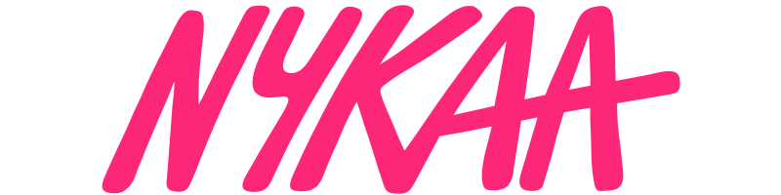





Business Analysis
By: Thambidurai Sundaramoorthy

Slide 2

INTRODUCTION:
In April 2012, Falguni Nayar, a former managing director at Kotak Mahindra Capital Company, founded Nykaa as an ecommerce portal curating a range of beauty and wellness products.
Nykaa, is an Indian retail company, headquartered in Mumbai. It sells beauty, wellness and fashion products through its website, mobile app and over 100 physical stores. Nykaa sells products which are manufactured in India as well as internationally. In 2015, the company expanded from online-only to an omnichannel model and began selling products apart from beauty. Nykaa follows an inventory-based model with warehouses in Mumbai, New Delhi, Pune, Haryana, Kolkata and Bangalore. It has three offline store formats called Nykaa Luxe, Nykaa On Trend and Nykaa beauty Kiosks.
Beauty
Fashion
Home Decor
In-house brands

Slide 3


Brand Perception Analysis:
Advertising
Product Quality
Online marketing through YouTube & social media like Instagram and Twitter by posting product-oriented content, and to collaborate with influencers to create tutorials and reviews. Spent 2365 Million on marketing during 2nd quarter of FY25.
Over 2500+ brands selling through Nykaa including both Indian and International brands. Ensures quality check on all products before dispatch. If damage occurs during transit, replacement and refund option is available
Customer Service
User Experience
Many ways to contact our customer support through phone, email, chat and Help Center. Customer support option is available 24/7.
Plenty of options to purchase products through website, mobile applications and offline stores. Seamless UI in both website and mobile applications.

Slide 4


Customer Sentiment Analysis
Positive aspects
Negative aspects
Offers a vast variety of beauty and personal care products from diverse brands, catering to different needs and budgets.
User friendly app which is easy to navigate with helpful features like reviews, tutorials, and personalized recommendations.
Frequently runs promotions and offers attractive discounts on products.
Slow response times, unhelpful customer service representatives, and difficulty with returns and refunds.
Delayed deliveries, incorrect products being sent, or damaged packaging.
While Nykaa claims to sell genuine products, a few users have raised concerns about receiving fake or expired items which has got product authenticity doubts.
Fashion section of the platform often faces criticism regarding quality, fit, and return policies.

Slide 5





Over 2500+ brands
5 lakhs+ products
Targeted age group of 18 to 5-0
Nykaa
Beauty products
Wellness Products
Market Trend Analysis
Beauty & Wellness Prod.
Nykaa Fashion
Cosmetics
Skin Care
Perfume
Hair Color
Personal Care
Fashion & lifestyle products
Clothing
Accessories
Home decors and more
Variety of offers
Nykaa Man
Deals of the day
In-store offers
Coupon codes
Gift vouchers
Upcoming sales
Men's shopping app that offers a variety of products, including skincare, fragrance, footwear, clothing, and gadgets

Slide 6
Highlights (Real-Time)
User friendly UI
Original Cosmetic brands
Pink Sale
Affordable prices with offer

Slide 7

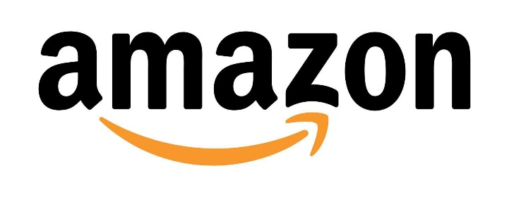
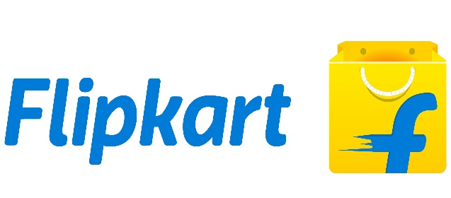

Competitor Analysis
Brands | Focus Area | Product Selection | Pricing & Discounts
 | Primarily focused on beauty and personal care products, including makeup, skincare, haircare, and fragrances. | Curated selection of high-end and niche beauty brands, including international labels, alongside their own private label products. | This tends to be slightly more expensive due to its focus on premium beauty and personal care products as its high-end brands and focus on quality. May offer exclusive discounts and promotions on its own private label products. Often incentivizes loyal customers with additional discounts and rewards.
 | Offers a vast array of fashion items, including clothing, accessories, and footwear, with beauty products being a smaller segment. | Diverse range of brands across different price points, including luxury and more affordable options, with a wider variety of fashion items. | Offers a vast array of brands and products, leading to wider price ranges depending on the specific item. Known for frequent price drops and competitive pricing, especially during sales periods. Prime members often get access to exclusive deals and faster delivery.
 | Similar to Amazon, with a large range of products across categories including fashion, electronics, and home goods, but with a stronger focus on local Indian brands. | Large selection of fashion brands, often with deals and discounts, with a strong focus on local Indian labels. | Provides a diverse selection of fashion and beauty items at various price points. Often engages in aggressive price strategies, especially during major sales like Big Billion Days.
 | Primarily focused on fashion with a mix of premium and mid-range brands, often featuring exclusive collections. | Mixture of high-end and mid-range fashion brands with a focus on trendy styles and exclusive collections. | Similar to Nykaa, Ajio often features high-end fashion brands with a slightly premium price tag. This may leverage its buying power to offer competitive prices on certain items.

Slide 8
Overall Analysis
For dedicated beauty shoppers seeking a curated selection of high-end brands with expert advice, Nykaa is the preferred choice for the customers.
For a wider range of fashion items across various price points, Amazon Fashion and Flipkart are better options for the customers.
Prioritizing trendy fashion with exclusive collections, Ajio is being be a good choice for the customers.

Slide 9
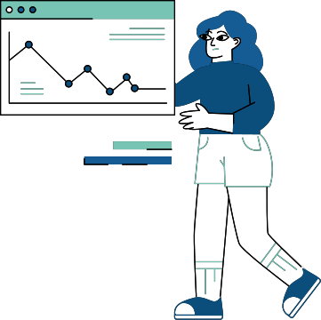


Strategic Recommendations
Key Findings
Recommendations
Delayed Delivery
Focus on on-time deliveries to satisfy the customer
Customer Service
Response time should be faster and representatives should be friendly to satisfy the customer
Fashion Products
Focus more on fashion products in terms of quality, fit and return policy

Slide 10
THANK YOU!

